Slide 1


VISION AND STRATEGY senior director of Analytics, Data Science & Learning Innovation
Lee Duncan
Advanced analytics & ml leader

Slide 2
summary
I'm a strategic analytics leader with a proven track record of unifying fragmented teams, scaling AI and data science capabilities, and delivering measurable impact across complex organizations.
I bring the rare combination of hands-on technical expertise, deep leadership experience, and a sharp focus on outcomes that matter: equity, engagement, and effectiveness. My approach is people-centered, mission-driven, and built to scale.
What excites me about this opportunity at WGU is the chance to shape a newly consolidated function into a powerful, integrated engine for student success and learning innovation.
This deck outlines how I would approach building trust, accelerating value, and positioning analytics as a transformative force at WGU, not just in operations, but in how the institution learns and evolves.

Slide 3

AGENDA
Guiding principles
roadmap
Team integration keys
Success metrics
Appendix 1: about me
Appendix 2: strategy example

Slide 4







Guiding principles (Adaptable based on learnings in role)
MISSION-ALIGNED
(student success, learning at scale)
DATA AS AN ENABLER
(prescriptive insights, practical AI)
PEOPLE FIRST CULTURE
(clarity, collaboration, empowerment)
SCALABLE INNOVATION
(AI/ML with clear value)
INFLUENCE
(compelling, data driven storytelling)
INNOVATION
(research, exploration, partnerships)

Slide 5

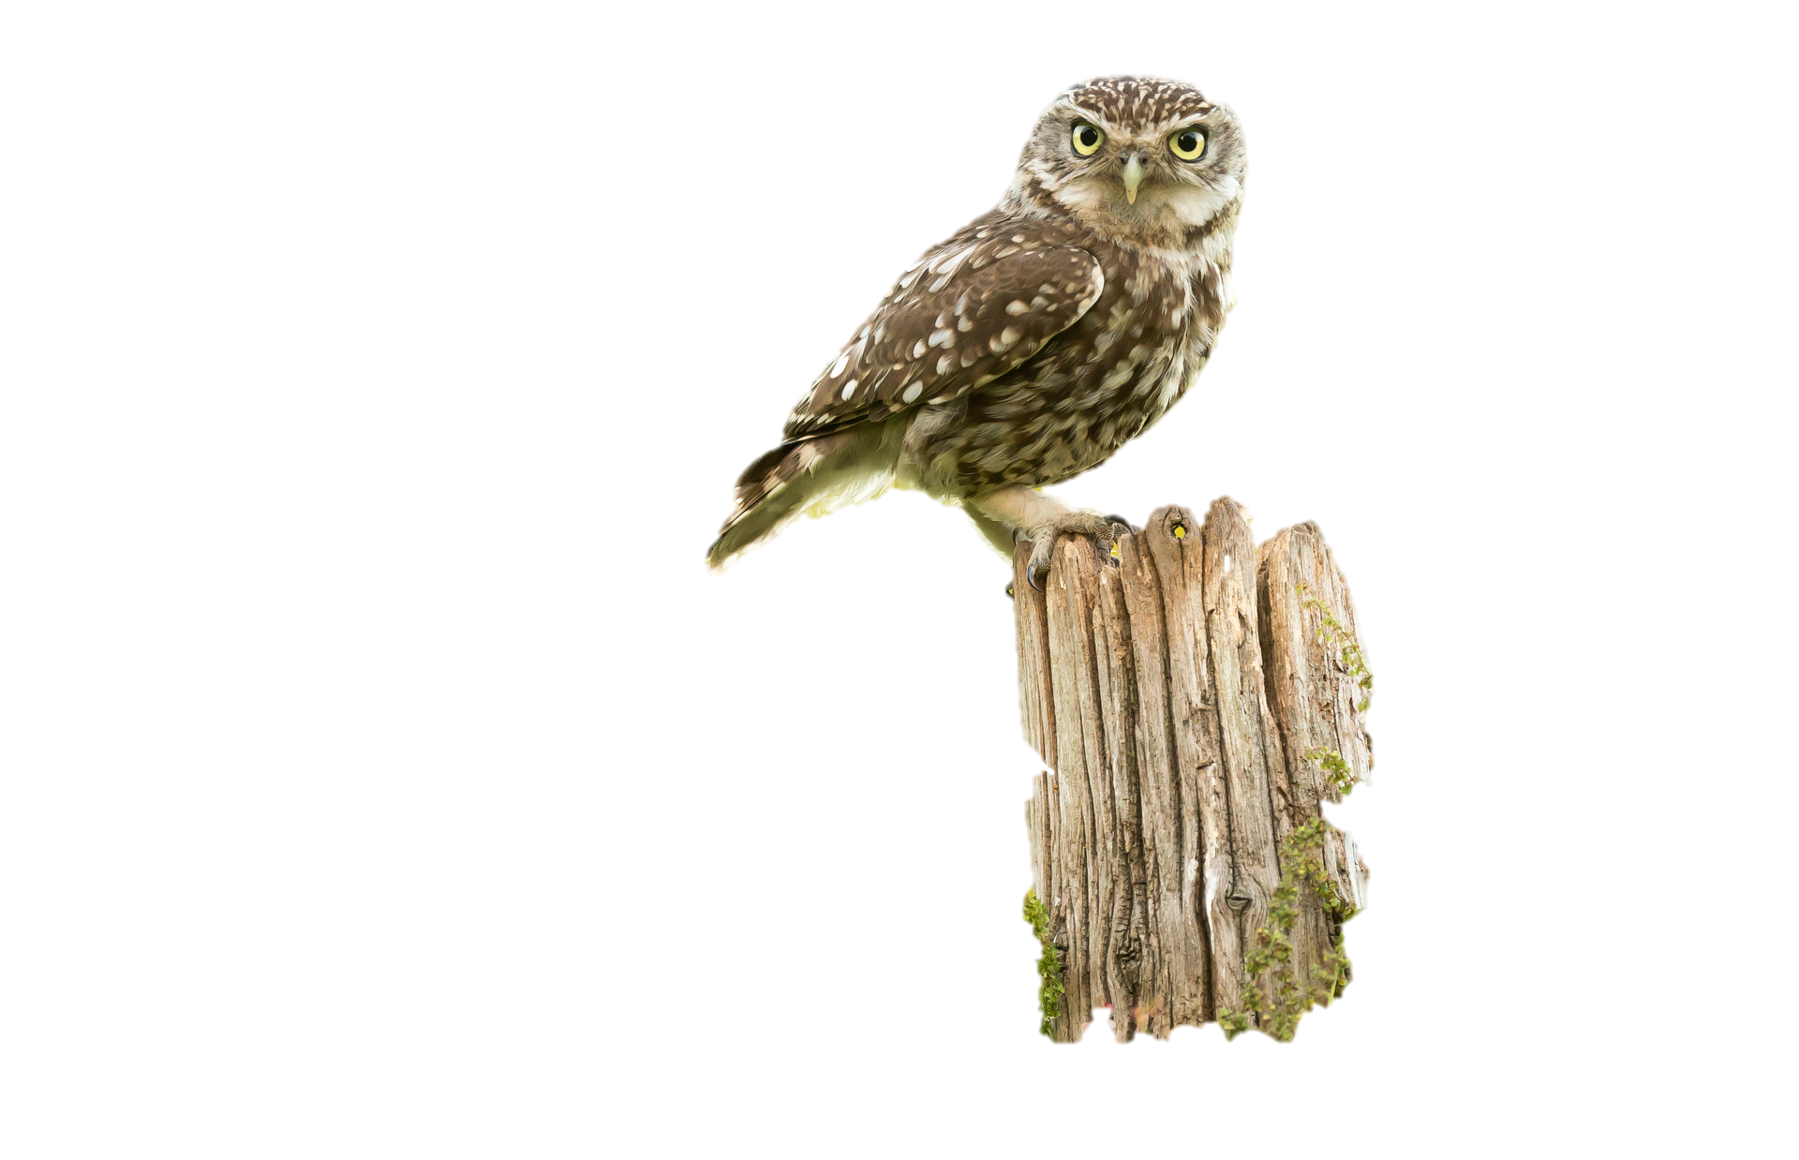


90-day roadmap (high level) (Adaptable based on learnings in role)
Output:
Embedded analytics in day-to-day decisions and strategy.
Team seen as a core partner
to the mission of student
success and innovation.
Output:
Unified tools, workflows, and standards in place.
Demonstrable results from initial AI/analytics initiatives.
Output:
A single, integrated team with early wins and cross-functional alignment.
Internal roadmap developed and socialized.
BEYOND
PHASE 3: days 181 to 365
TRANSFORMATION & ADAPTATION
Prescriptive Analytics
Simulation and optimization
Scenario planning
Closed Loops
Reinfrocement learning
Agentic AI
Institutional Agility
Rapid response to trends
Embedded AI tools
Generative Impact
Adaptive journeys
Augmented, Amplified, Automated
PHASE 2: days 91 to 180
IMPACT & INNOVATION
Student Impact
Learner success models
Smart nudges / NBA
Data driven feedback loops
Strategic Insights
Live dashboards and simulations
Stakeholder insight briefings
Influence
Embedded analytics
Team credibility & celebrations
PHASE 1: first 90 days
FOUNDATION & ACCELERATION
Operating Model
Intake & prioritization structure
Community development
Infrastructure
Streamline pipelines
Governance
Refine deliverables
AI/ML Momentum
Responsible AI standards
Deploy 1-2 new models
AI/ML Ops evaluation
INTEGRATION & TRUST
Team
Listening sessions
Skills assessments
Stakeholders
Needs assessment
Preferences
Synergy
QFD (skills vs needs)
Org design
Quick wins

Slide 6







Team Integration keys (Adaptable based on learnings in role)
Unification and teamwork
Team 1
Team 2
Org evaluation
Faculty
& Curriculum Analytics
Shared vision + operating rhythm
Elevate strengths of each team and member
Establish foundational norms
I have unified multiple teams several times in my career.
Team 3
Notes:
FACTS – Faculty & Curriculum Transformation Sciences

Slide 7





proposed success metrics (provisional) (Adaptable based on learnings in role)
Team Health
(retention, engagement)
Stakeholder Satisfaction
(feedback, reviews)
Analytics Adoption
(usage, models)
Student Success
(satisfaction, graduation)
Operational Efficiency
(cost, speed)

Slide 8

Appendix 1 about me
*Example only. Actual approach would be contingent on needs and learnings in role.

Slide 9
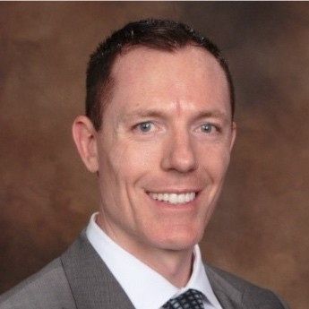








ABOUT ME
Experience
Approach
30 Years of leadership experience
20 Years of analytics and A.I.
10 Years in Tech
Process improvement mindset
Data and A.I. toolkit
Strategy and action
Lee duncan
Education
Achievements
Masters in Statistics (honors)
Bachelors in Mathematics
Dozens of Certifications
Hundreds of millions in annual value
Multiple innovative solutions
Culture and collaboration successes
Leadership
Skills
Founded many teams
Led orgs in size from 15 to 250
Collaborator and influencer
Programming, ML, AI
Program / Project Management
Thought leadership
Career Goals
Personal Interests
Broader influence
Scale analytics and AI programs
Develop new leaders
Family & friends
Health & fitness
Learning & creativity

Slide 10









experience
Shipping industry leadership.
Started as labor. Several promotions in ten years.
$30M budget
250 FTE
Dozens of certifications / nanodegrees.
Master of Statistics,
Business
Two promotions.
B.S., Mathematics
Founded, developed, and grew several data science teams.
Billions in value.
1994 - 2004
2004 - 2014
2014 - Present
30 Years of leadership experience
20 Years of leveraging analytics and A.I.
10 Years in Telecom / Connectivity

Slide 11
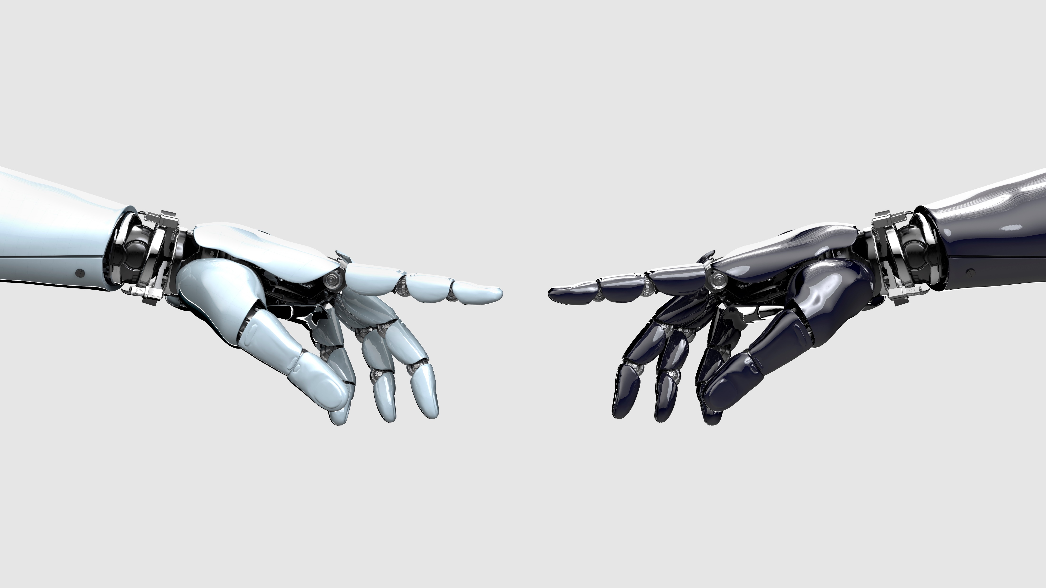
Key skills
Quantitative
Qualitative
Artificial Intelligence
GOFAI, ML, Generative AI
Machine Learning
Supervised, unsupervised, reinforcement learning
Deep Learning
CNNs, RNNs, GANs
Data and Programming
SQL, NoSQL, Python, VBA
Analytics
Visualization, RCA, exploratory
Prescriptive Methods
Optimization, simulation
Math and Statistics
Inference, time series, DOE
Business Leadership
Diplomacy, influence, vision
Team Leadership
Mentoring, motivation, delegation
Strategy
SWOT, scenario planning, QFD
Program Management
Stakeholdering, operating models, resourcing
Project Management
Planning, risk, comms
Communication
Engagement, reporting, resolution
Master of Statistics in Business
Interdisciplinary Graduate Degree
Synergy between MBA program and Graduate School of Mathematics
Six Sigma Black Belt
Applies scientific method to business process improvement

Slide 12
SAMPLE OF Achievements
Created generative AI vision for Consumer Mass Markets. Founded team. Secured funding for $500M in generative AI use case value with 200% IRR over 5 years.
Shaped vision for Broadband Marketing Advanced Analytics approach. Pitched the idea. Founded and scaled team.
Developed vision for Data, Insights, and Customer Experience Machine Learning. Founded and scaled team.
Founding member of generative AI Governance and Review Board, contributing to strategic and ethical oversight.
Founded data science community. 300+ members. Hackathons, speaker series, learning sessions, communication forums.
Directed development of machine learning models delivering $300M in annual value, driving improvement in areas such as churn, marketing strategy, and capital expenditure.
Oversaw development of generative AI call transcript insight extraction for over 9 million calls per month, reducing ambiguity in CX and influencing crucial business decisions.
Created innovative Gen AI approach to identify next best action.
Developed genetic algorithm and stochastic simulation for call center labor optimization.
Trimmed $60M from rental lot labor through linear programming models.
Developed automated root cause analysis, accelerating speed to insights. Applied to call center and CX metrics.
Oversaw development of gen AI agent-based evaluators for topline CX metric (NPS).
Developed novel heuristic approach to balancing queue time.
Improved customer sentiment using interpretable ML regression models to identify actionable factors.
Rapidly improved call center queue time via analytics, queuing theory, simulation, and optimization.
Developed automated time series analysis.
Developed novel genetic programming regression model.

Slide 13
CASE STUDY: FIBER CUSTOMER CHURN MODEL
Very difficult to improve Broadband customer retention. Most common approach was to incentivize with recurring credits. (i.e., buy loyalty)
Developed machine learning model showing that churn was predictable.
Proposed proactive routing of high churn risk customers.
Customers in top 2 deciles for churn likelihood are routed directly from IVR to retention. Technical and collections calls are excluded.
3k incremental customers retained per month.
$120M in customer value per year.
$60M net value
compared to control.

Slide 14

CASE STUDY: GENERATIVE AI INTEGRATION
Limited strategy for AI in Mass Markets. Hype cycle driving awareness and interest. Resources spread across teams. Duplicated and wasted efforts across organization.
Create generative AI program in Mass Markets to accomplish multiple goals including adoption and identification of use cases with clear ROI.
Developed vision, strategy, team, and operating model to identify needs and match with solutions.
Created POCs.
Developed training programs.
$500M in gen AI use cases.
Drove adoption from 0% to 50%.
Use cases scaled to enterprise.
Scope expanded to include all AI capabilities.

Slide 15
Appendix 2 real world strategy example
*Example only. Actual approach would be contingent on needs and learnings in role.

Slide 16





Strategy: VISION
To establish your company as a leader by harnessing AI to revolutionize customer experiences, streamline operations, and foster continuous innovation.
Enhance Customer Experience: Utilize AI to deliver personalized, efficient, and responsive customer interactions.
Optimize Operations: Leverage AI to improve operational efficiency, reduce costs, and enhance productivity.
Drive Innovation: Develop AI-driven products and services that differentiate Vonage in the market and create new revenue streams.
Ethical AI: Implement AI ethically, ensuring fairness, transparency, and accountability.
*Contingent on learnings in role.

Slide 17













Strategy: operating model
Resources
Vision
Create: Dev new solution
Strategy
Collaborate: Codevelop solution
Playbooks
Consult: Tech existing solution
Evangelize
Portfolio
Ranking
Backlog
Needs
Partnerships
Solutions
Funding
Infrastructure
Research
Continuous Improvement
Governance
*Contingent on learnings in role.

Slide 18

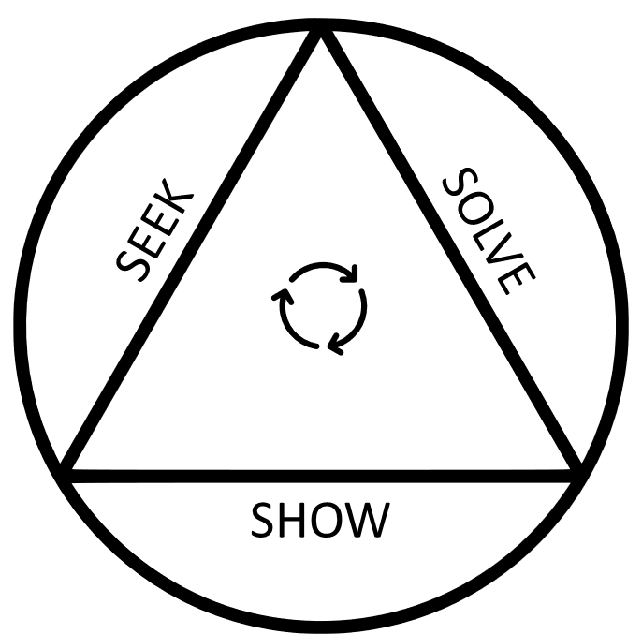
Strategy: Engagement model
Accelerate • Amplify • Augment • Automate
Consult • Create • Collaborate
Work with idea partners to identify business needs.
Resolve needs through team & expanded solutioning network.
Teach the organization about the platforms, tech, and tools available to them and our customers.
*Contingent on learnings in role.

Slide 19

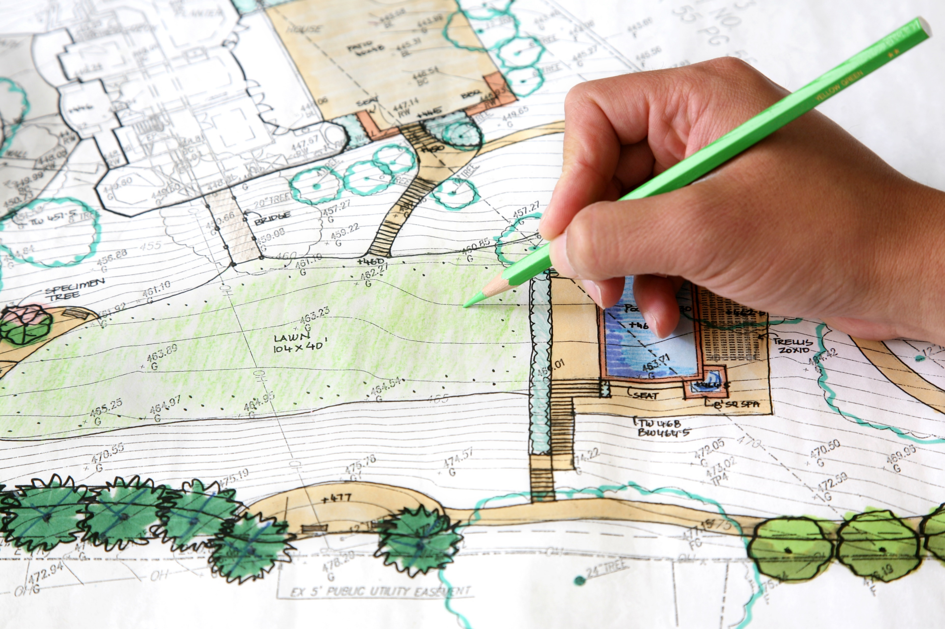




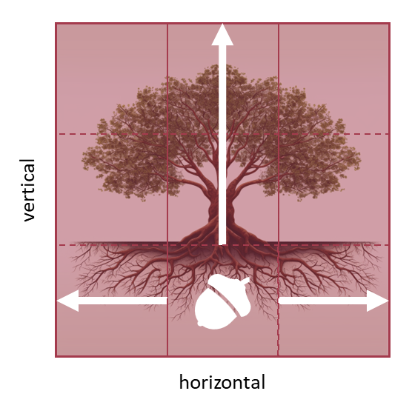
Strategy: Keys to success
Infrastructure
Team
Scalable compute
Data management
Tools & platforms
Data scientists
ML engineers
Project managers
Mentorship programs
Continuous learning
Scrappy POCs
Partnerships
Governance
Internal domains
Industry
Internal communities
Academic
Governance board
AI policy
Ethical guidelines
Transparency and accountability
Finance
Value Expansion
Development funding
ROI metrics
Operational budget
Expand vertical use cases horizontally.
Expand horizontal use cases vertically.
*Contingent on learnings in role.

Slide 20


Strategy: roadmap
PHASE 3
EVOLVE
Optimization: Continuously optimize AI models and processes for better performance. Versioning and champion challenger frameworks. Monitor for drift.
Innovation Lab: Establish an AI innovation lab to explore cutting-edge technologies and new applications.
Continued Expansion: Scale successful AI initiatives across the enterprise.
Communities: Foster innovation through events like hackathons.
PHASE 2
EXPAND
Infrastructure: Invest in scalable AI infrastructure, including cloud services and data storage.
Integration: Integrate AI solutions with existing systems and workflows.
Scale: Expand vertically and horizontally.
Portfolio: Continue to identify new use cases.
Continuous Learning: Implement feedback loops and continuous learning mechanisms to improve AI models. Keep team member skills up to date.
PHASE 1
ESTABLISH
Readiness: Evaluate current AI capabilities and infrastructure. Develop operating model.
Relationships: Establish connections with critical stakeholders.
Governance: Found AI governance board.
Data: Develop a robust data governance framework and ensure data quality and accessibility.
Talent: Hire or train AI specialists and data scientists.
Portfolio: Launch pilot projects for high-impact use cases.
*Contingent on learnings in role.

Slide 21





THANK YOU
Lee Duncan
(801)245-0658
www.linkedin.com/in/leeduncanstat/
lee@smartxltools.com

